Slide 1
AirKitchen:
Week5 Update
Team FoodXYZ
Mengdan Yuan, Wen Xin

Slide 2


Slide 3
Feature Engineering
Problem: predict whether a user will place an order in the next two weeks
Each row in the training set represents a user
Features:
Daily features:
Count of orders in a day: 04/04/2016count
Most common send type : 04/04/2016send_type_mode
Sum of Coupon worth money: 04/04/2016couponworth_sum
Sum of Ticket fee:04/04/2016ticketfee_sum
Sum of Coupon fee:04/04/2016couponfee_sum
User basic features part:
User basic information:City, sex, age, occupation, login_platform
Kitchen user visited most frequently:kitchen_id,kitchen_orders
Send time: overall_time, update2send_time

Slide 4
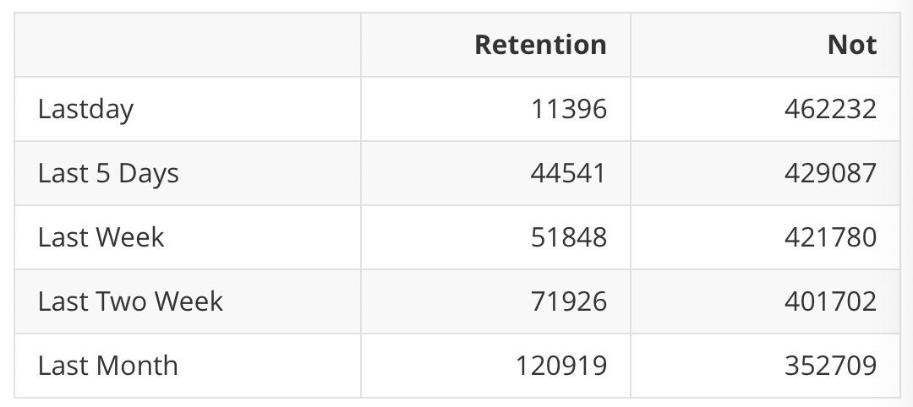
Retention Rate Analysis

Slide 5
Next Step
Build and evaluate the baseline model: lightgbm
Outliers detections
Research existing methods of user retention prediction
Explore other feature engineering methods
Notes:
Whether your customers are people or businesses, and no matter if you're selling products or services, the problem is still the same: Keeping current customers while continuing to grow with new ones. This means understanding who is no longer a buyer and why they've chosen to leave. Once you have the answers, you can work on your retention practices to prevent similar losses in the future.
If the prediction matches the actual status of the customer, then there is no action necessary. However, if an active customer is predicted to be a churned customer, this will imply that this customer is at-risk of churning. Alternatively, if a customer is currently inactive (meaning that they previously churned), but the prediction is that they are an active customer, this may indicate that they are a good target with which to attempt to reinstate business.

